Slide 1
eduID tests
- short description of current tests
2020-10-13

Slide 2
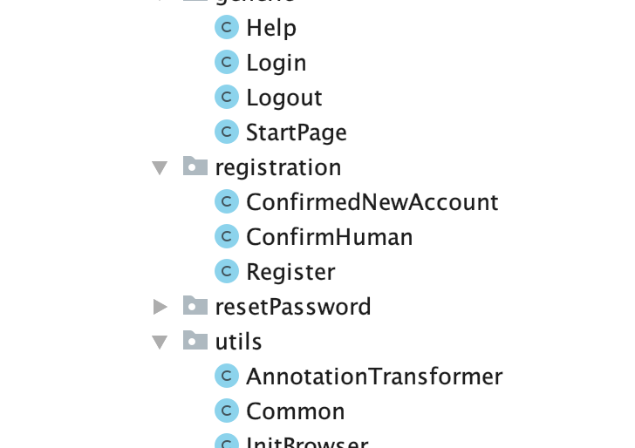
Test case design?
- One class for each webpage
In general, one class for each web page
Generic classes for support like initiate web bowser, screen shots when failing tests etc
In general, all pages are verified in both English and Swedish
Bildtext

Slide 3
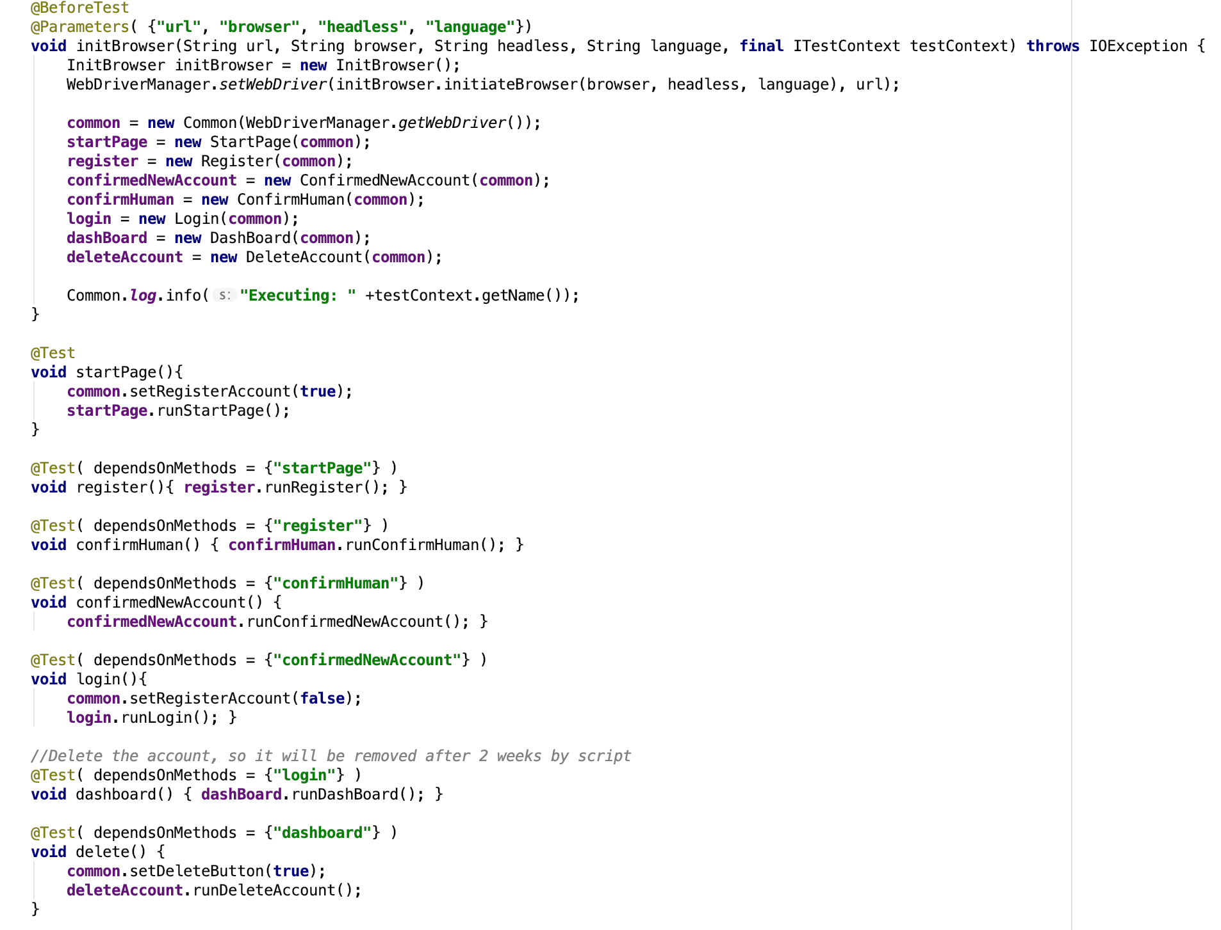
Test case design?
- Test case example - Test case 38 - Register new account
Selenium and testNG is used
Each test case calls the predefined classes/webbpages with required parameters.
Bildtext

Slide 4
Current test cases
- with a brief description
TC 1 - Log in and check account data and labels
TC 2 - Change givenName, surName and displayName
TC 3 - Check that dashboard names changed according to TC_2 and restore names to default
TC 4 - Change language to English
TC 5 - Check that dashboard language is english and restore language to default
TC 6 - Try to remove the primary email address
TC 7 - Add an additional email address and confirm it by code
TC 8 - Remove the additional email address added in TC 7
TC 9 - Try to add the default email address as extra email address
TC 12 - Add additional email address, try to confirm with incorrect code
TC 13 - Remove the additional email address added in TC_12
TC 14 - Try to add additional email address thats invalid
TC 15 - Add an extra email address and confirm it by clicking on link in email
TC 16 - Remove the extra email address added in TC 15
TC 17 - Initiate password change but abort at pop-up window
TC 18 - Initiate password change but abort instead of save new password
TC 19 - Change password, use recommended
TC 20 - Change password, use custom
TC 21 - Initiate password change but enter incorrect current password
TC 22 - Initiate password change but choose a too week password

Slide 5
Current test cases
- with a brief description
TC 23 - Reset password with extra security (mobile OTP) and set a new custom password, use default pw
TC 24 - Reset password with extra security (mobile OTP) and set new recommended password
TC 25 - Reset password with extra security (mobile OTP). Set a new custom password, use default pw
TC 26 - Try to log in with incorrect password
TC 27 - Reset password with extra security (mobile OTP), resend mobile OTP once. Set a new custom password, use default pw
TC 28 - Try to reset password with incorrect magic code, ends with a 404-page
TC 29 - Reset password without extra security (mobile OTP). Abort confirmation of the phone number from dashboard
TC 30 - After reset password without extra security (mobile OTP). Enter incorrect code for confirmation of the phone number from dashboard
TC 31 - After reset password without extra security (mobile OTP). Confirm the phone number from dashboard
TC 32 - Initiate account termination but abort in confirm pop-up
TC 33 - Delete the account
TC 34 - Restore the account by reset password with extra security (mobile OTP) and set a new custom password, use default pw
TC 35 - Initiate Register of new account, abort at terms
TC 36 - Initiate Register of new account, abort at captcha
TC 37 - Initiate Register of new account, use incorrect magic code - results in failure at confirm human
TC 38 - Register a new account
TC 39 - Try to register new account with already existing user name
TC 40 - Register new account, add and confirm phone number. Confirm identity by phone
TC 41 - Register new account, add and confirm phone number. Confirm identity by mail
TC 98 - Confirm phone number on default account, to restore it from previous tests
TC 99 - Check the Help pages

Slide 6
What is actually tested?
- lets follow test case 38 - Register a new account

Slide 7
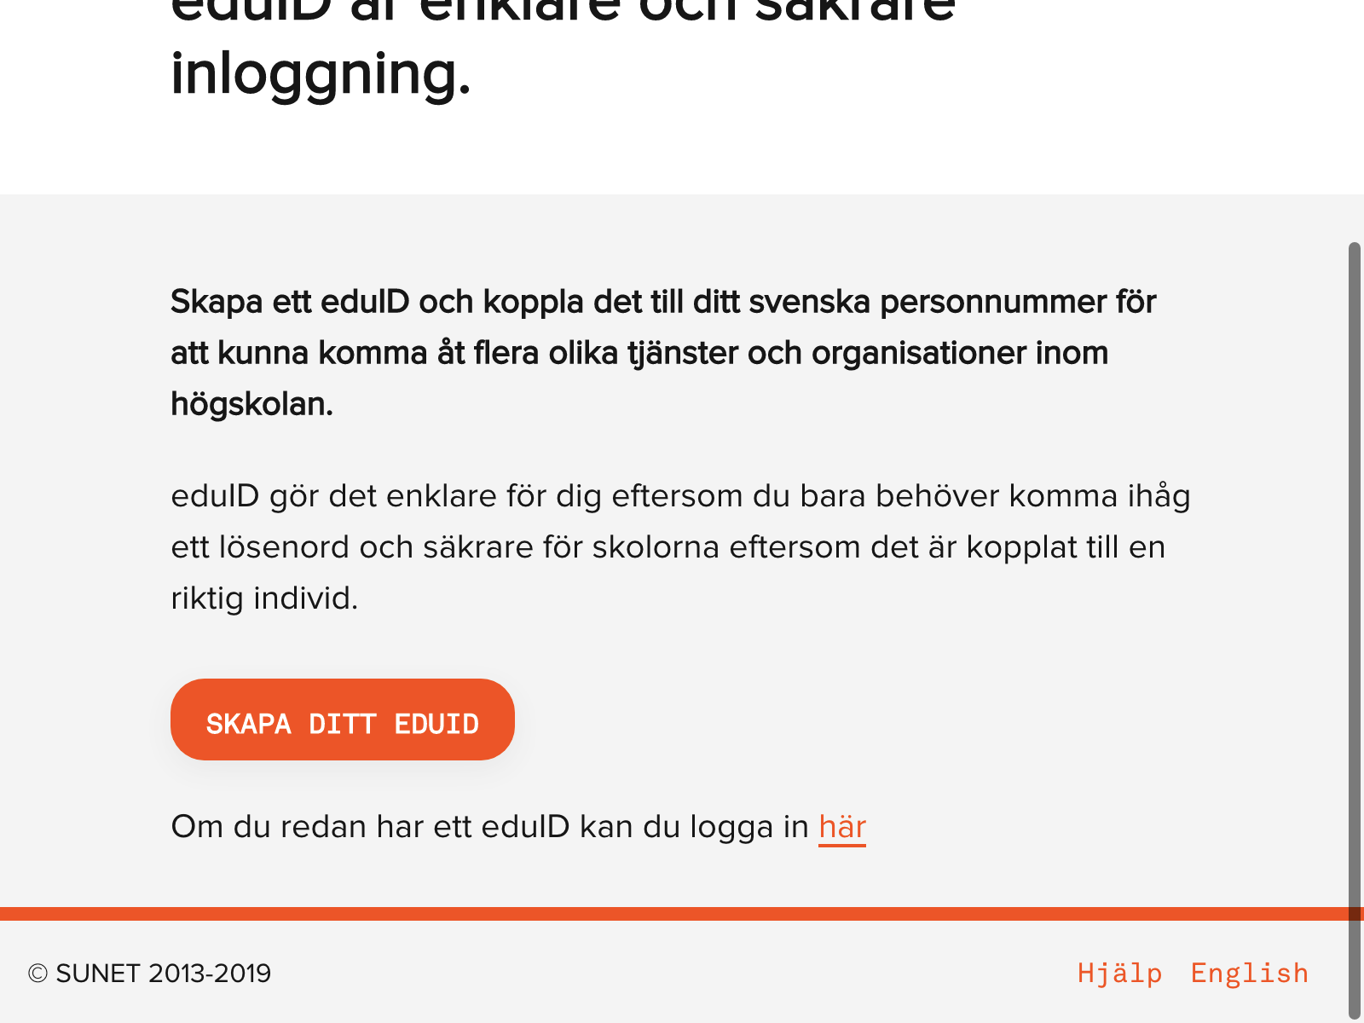
Test case 38 - Register a new account
- Start page
All tests start here
Page title, labels and texts are verified
Pressing ”Create account”
Bildtext

Slide 8
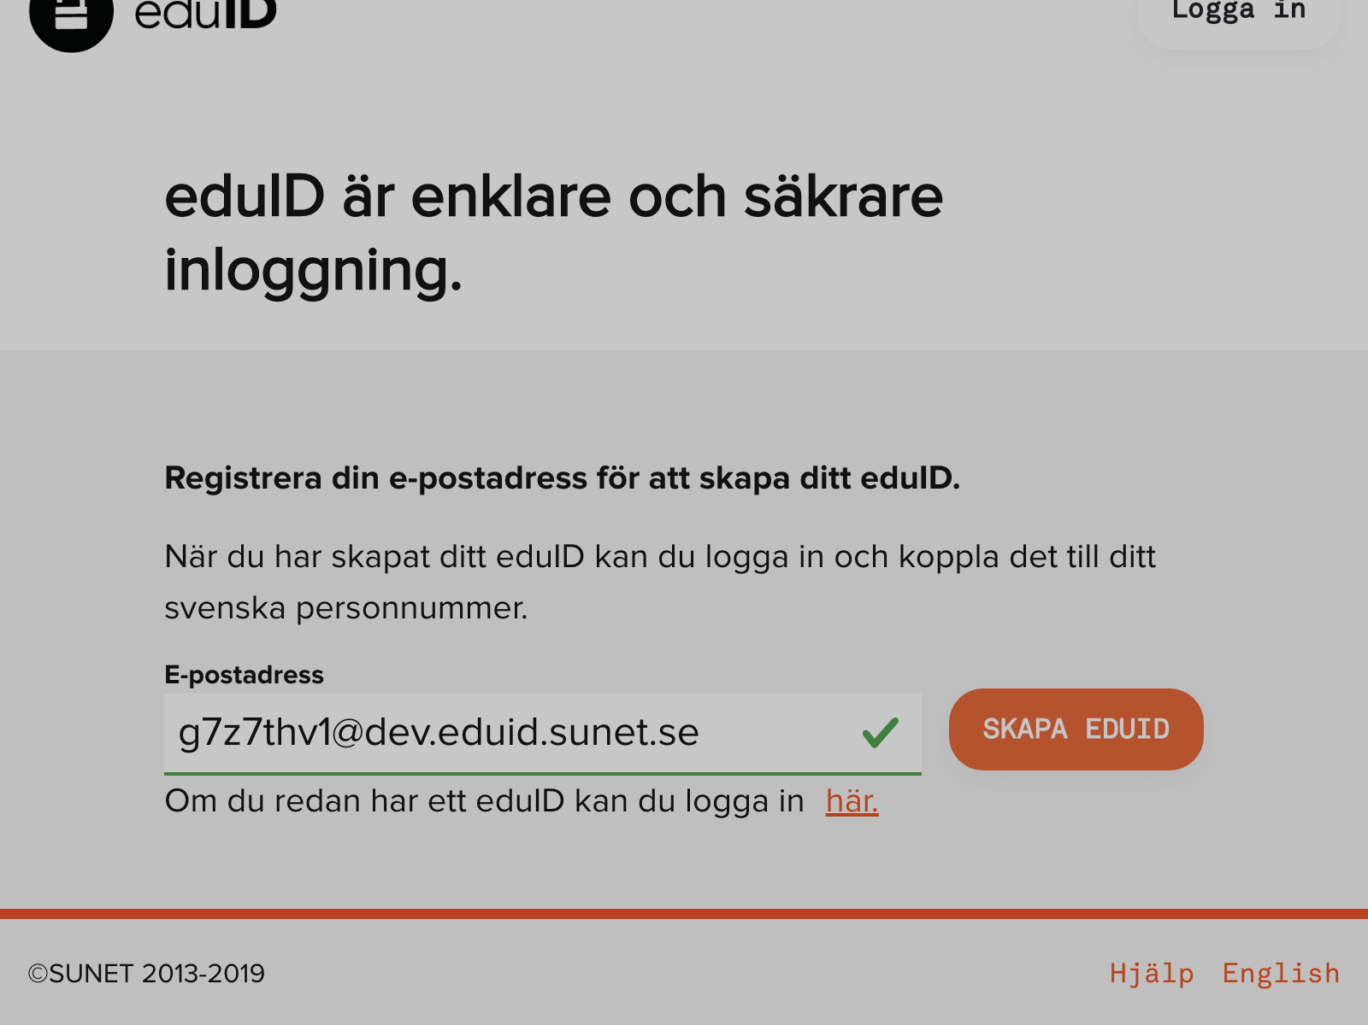
Test case 38 - Register a new account
- Enter email address
Labels and texts are verified
Generate an email address, all ending with @dev.eduid.sunet.se
Pressing ”Create account”
Bildtext

Slide 9
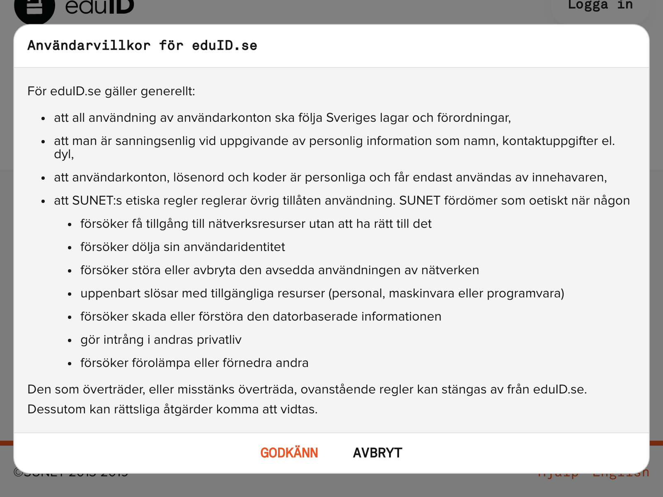
Test case 38 - Register a new account
- Confirm terms of conditions
Labels and texts are verified
Pressing ”Confirm”
Bildtext

Slide 10
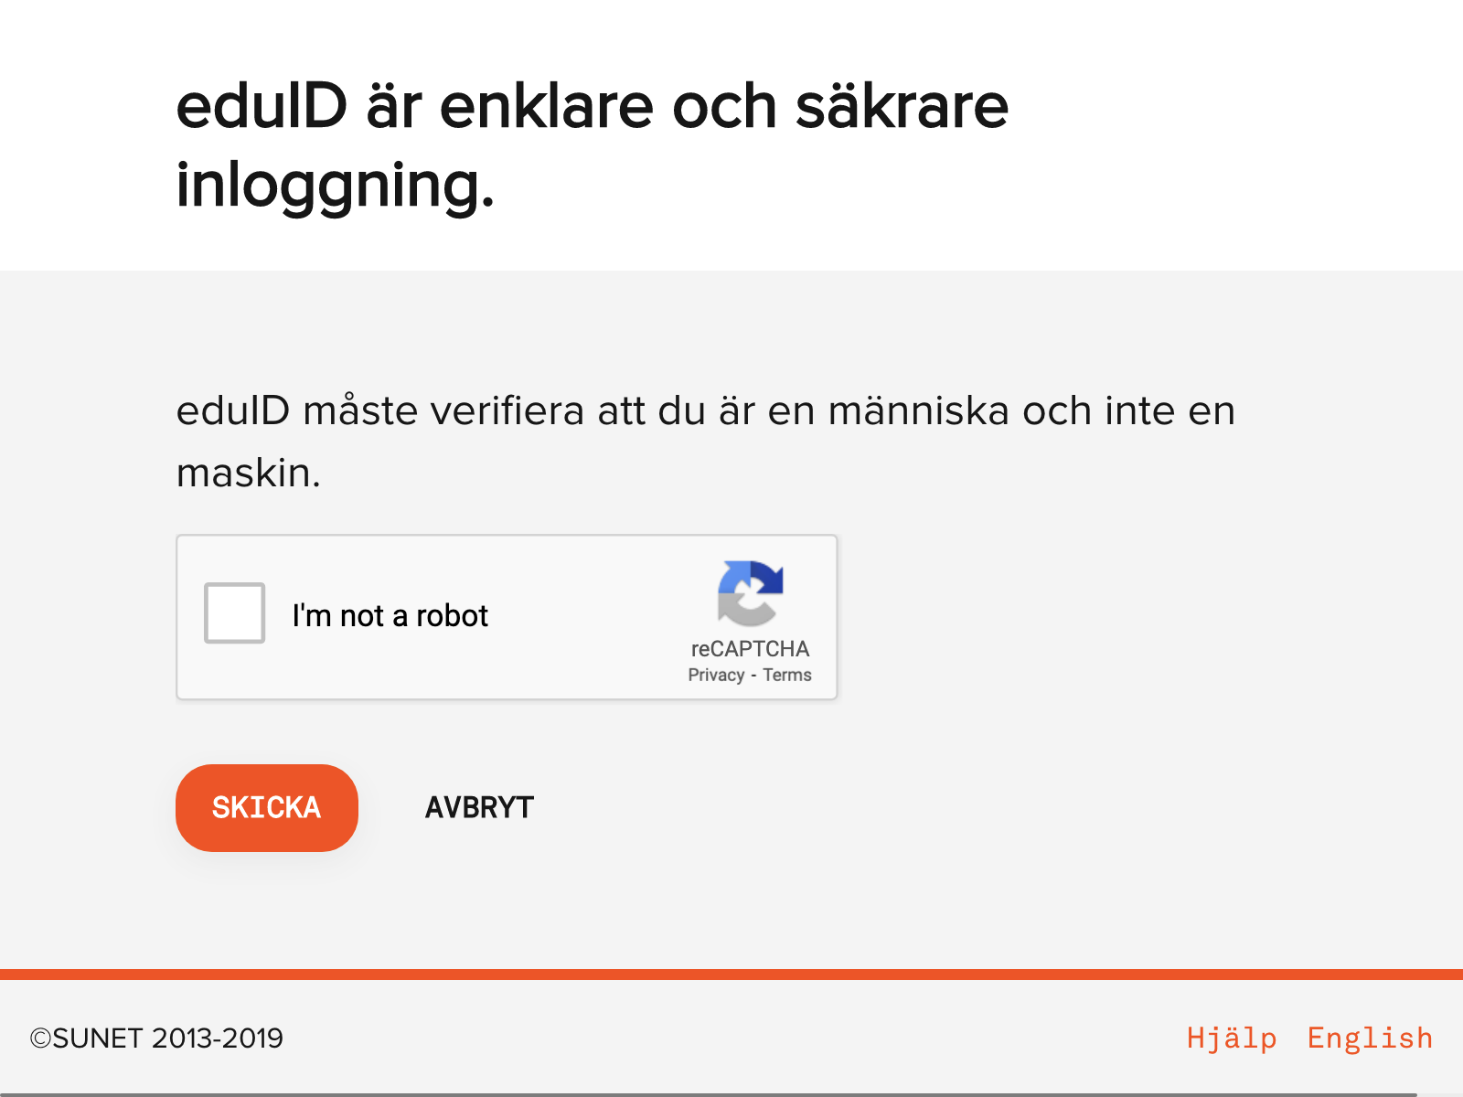
Test case 38 - Register a new account
- Confirm human
Labels and texts are verified
Pressing ”Send”
Bildtext

Slide 11
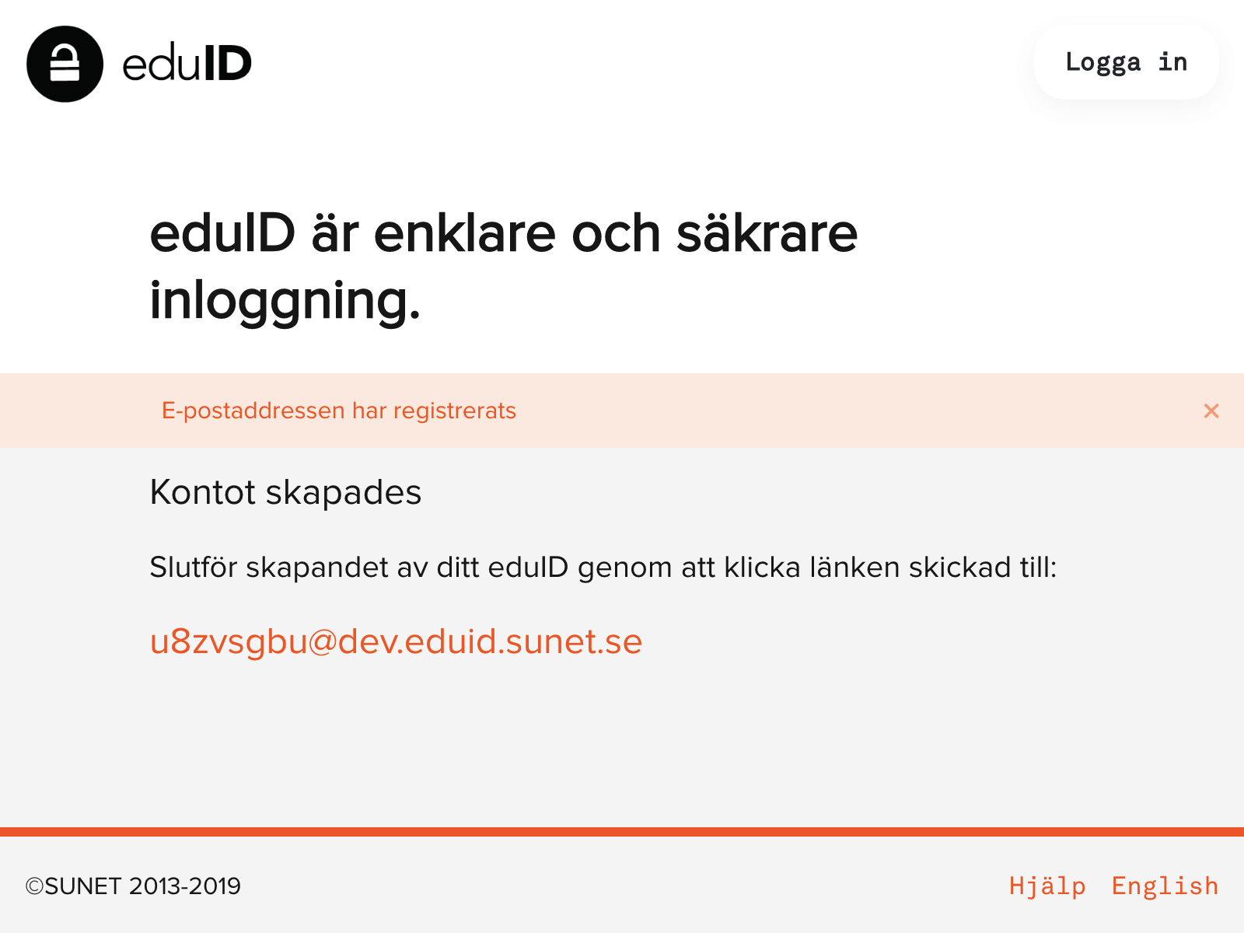
Test case 38 - Register a new account
- Confirm the new account
Labels and texts are verified
Verify that ”email successfully saved”
Using magic to finalize registration
Bildtext

Slide 12
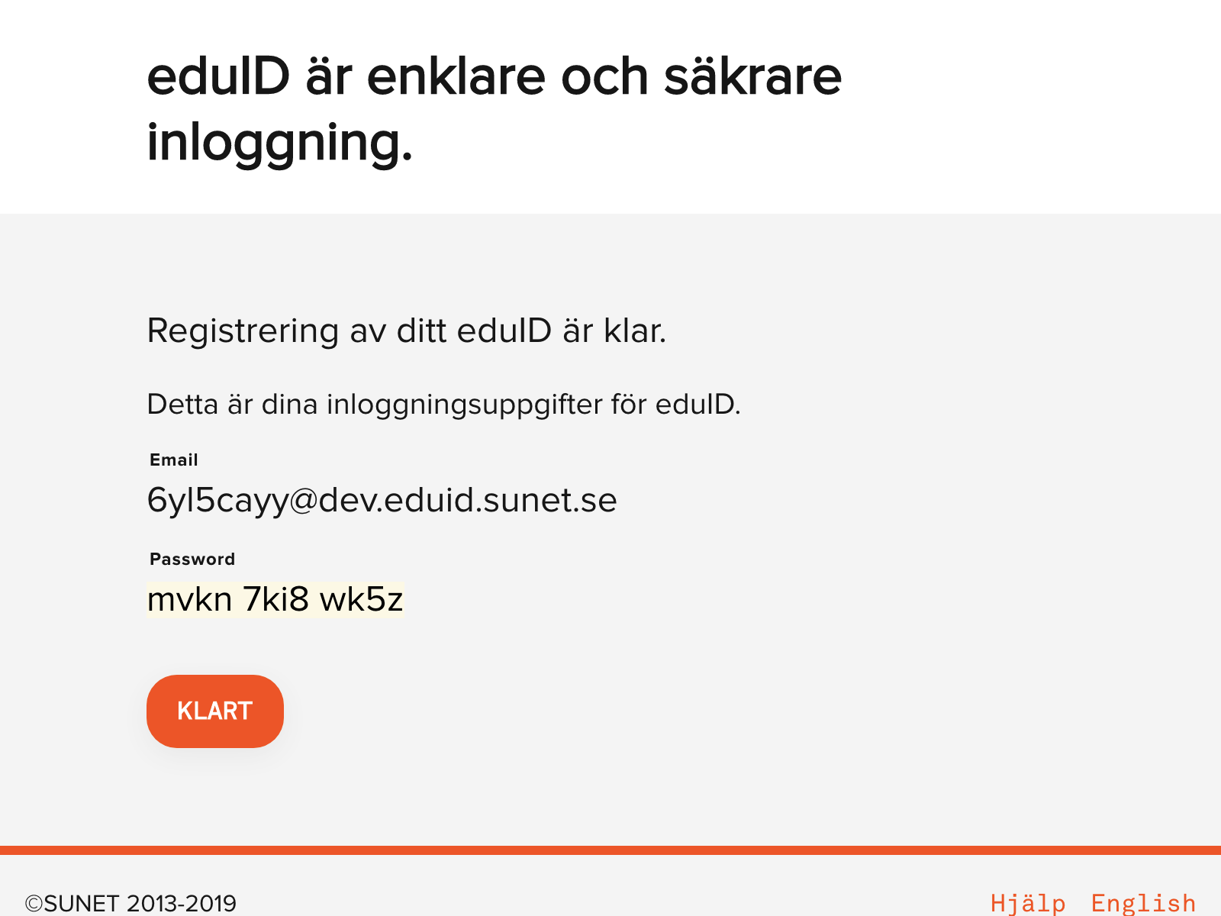
Test case 38 - Register a new account
- Confirmed new account
Labels and texts are verified
Saving user credentials
Pressing ”Done”
Bildtext

Slide 13
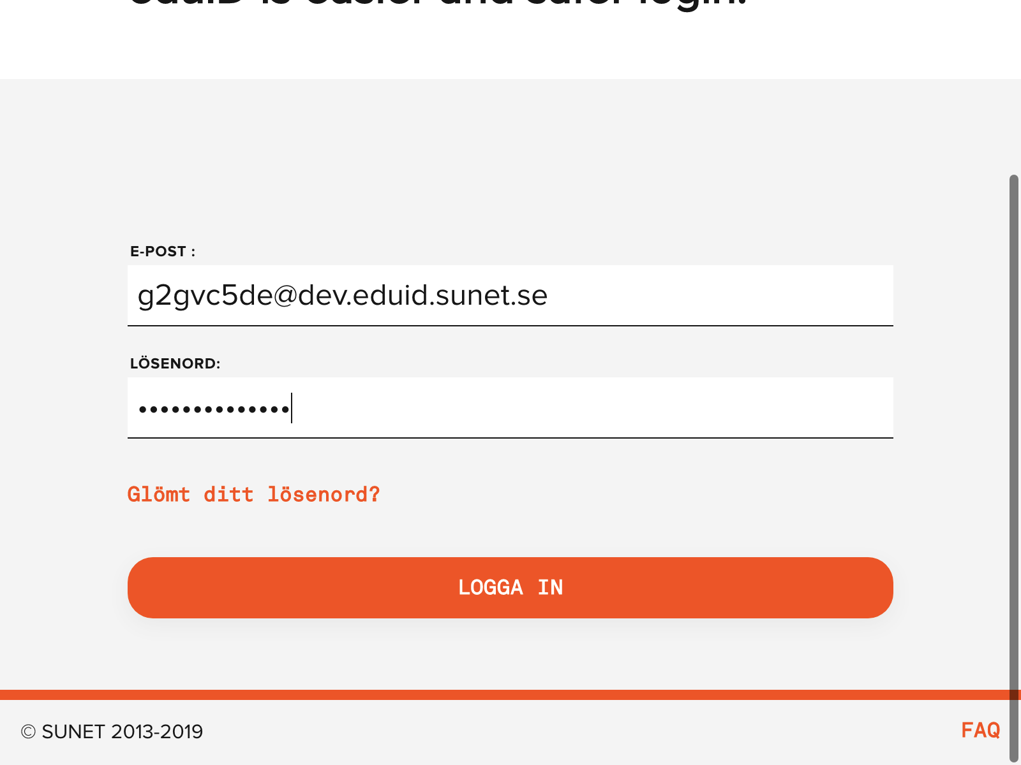
Test case 38 - Register a new account
- Log in with new account
Labels and texts are verified
Enter username/password
Pressing ”Login”
Bildtext

Slide 14
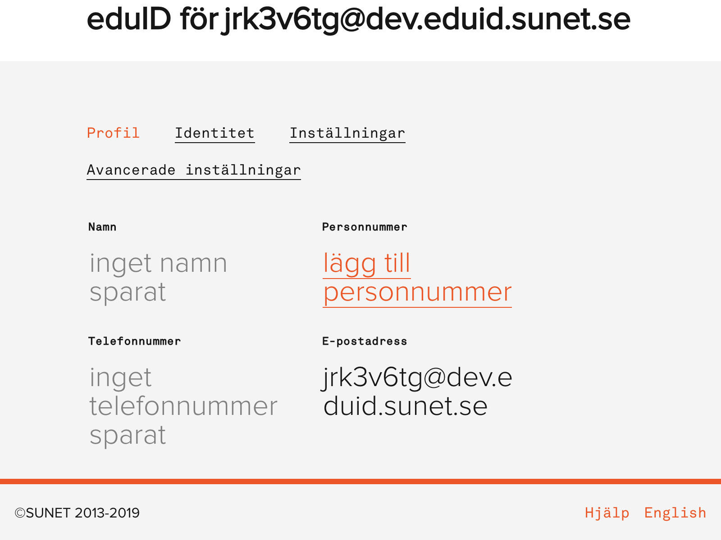
Test case 38 - Register a new account
- Dashboard
Labels and texts are verified
Verify Name, Number, Email etc
Pressing ”Settings”
Bildtext

Slide 15
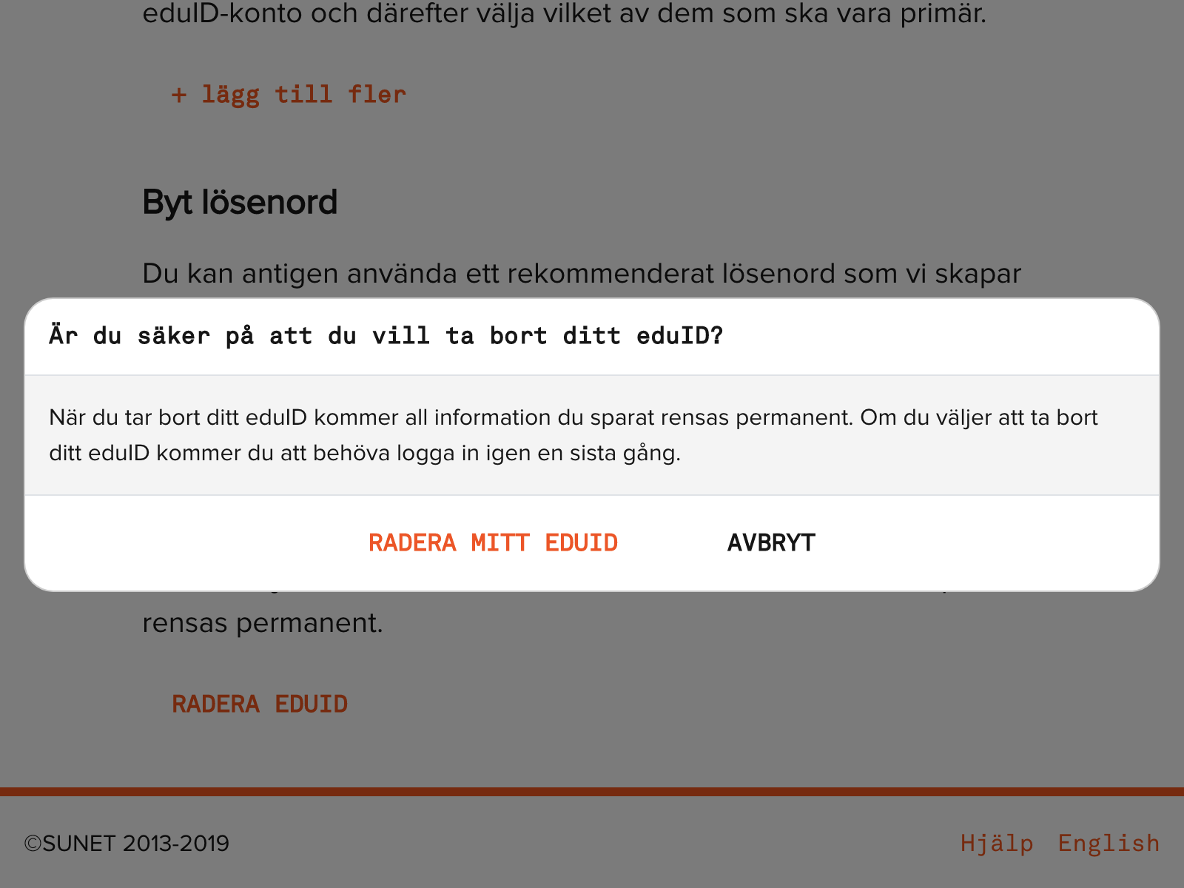
Test case 38 - Register a new account
- At settings page, press delete account
Labels and texts are verified
Confirming ”Delete account”
Bildtext

Slide 16
Test case 38 - Register a new account
- Log in one last time, to finalize the delete account
Labels and texts are verified
Pressing ”Log in”
Bildtext

Slide 17
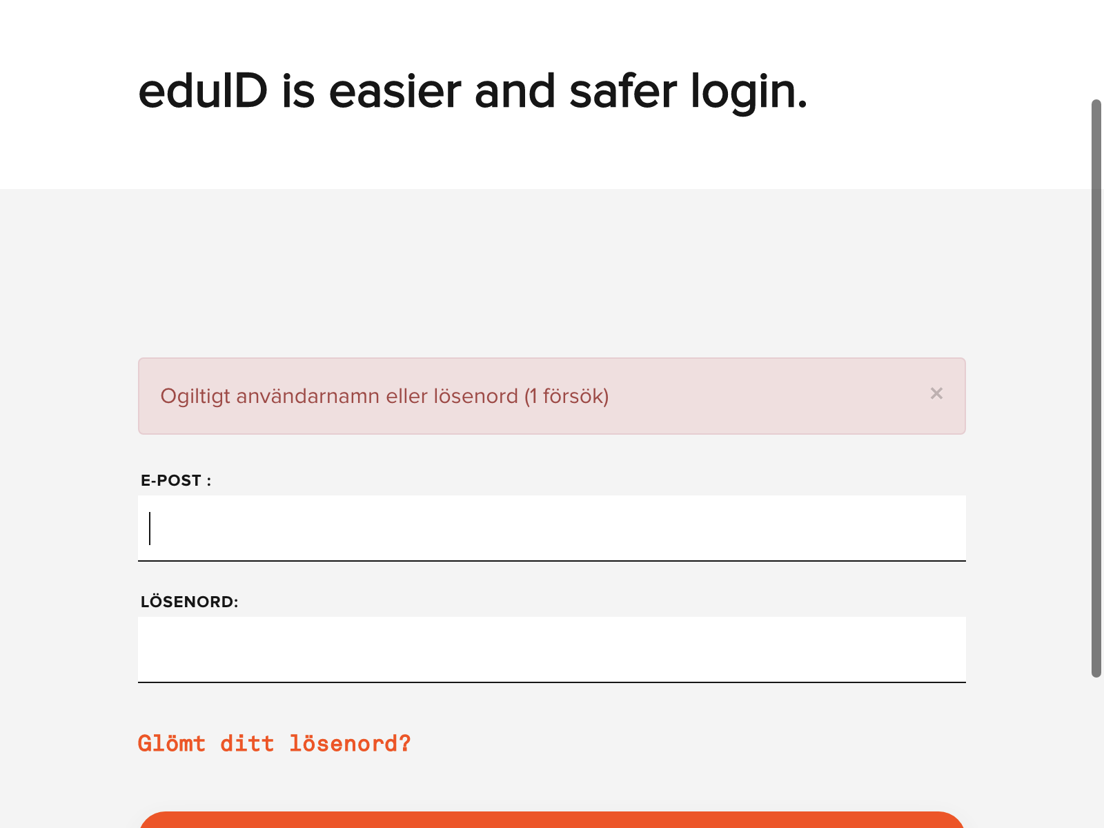
Test case 38 - Register a new account
- User account is deleted
Labels and texts are verified
Verify that user is not accepted
Bildtext

